Slide 1
A Probabilistic Future for Neuromorphic Computing
Brad Aimone
Center for Computing Research
Sandia National Laboratories
SAND2025-01773C

Slide 2
There is not a single roadmap for neuromorphic computing
Active research across the technology stack
New post-CMOS materials (memristors, ECRAM, MTJs, quantum materials, …)
Non-digital devices (analog, stochastic, optical, …)
Bio-inspired circuits (reconfigurable, dendrites, learning, …)
Neuromorphic architectures (spiking, event-driven sensors, ANN accelerators, …)
Software paradigms (compilers, intermediate representations, …)
Neuromorphic algorithms
When is it ready for prime time?
What is needed to get there?

Slide 3
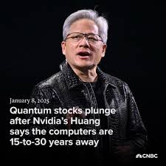
When will neuromorphic computing be a reality?
GPUs
Dataflow
Quantum Computing
Well described materials (i.e., silicon)
Well-understood but not conventional materials
Exotic materials
Today’s fabrication technology
Major scaling and fabrication challenges
Some scaling risk but fabrication possible
Demonstrated Applications
Prototyped Applications
Theoretical Applications
Stable programming model
Developing programming model
Uncertain
programming model
Now
5-10 years
10-20 years

Slide 4
Neuromorphic computing has promise at different time scales
GPUs
Dataflow
Quantum Computing
Neuromorphic
Neuromorphic
Neuromorphic
This Talk!
Well described materials (i.e., silicon)
Well-understood but not conventional materials
Exotic materials
Today’s fabrication technology
Major scaling and fabrication challenges
Some scaling risk but fabrication possible
Demonstrated Applications
Prototyped Applications
Theoretical Applications
Stable programming model
Developing programming model
Uncertain
programming model
Now
5-10 years
10-20 years

Slide 5
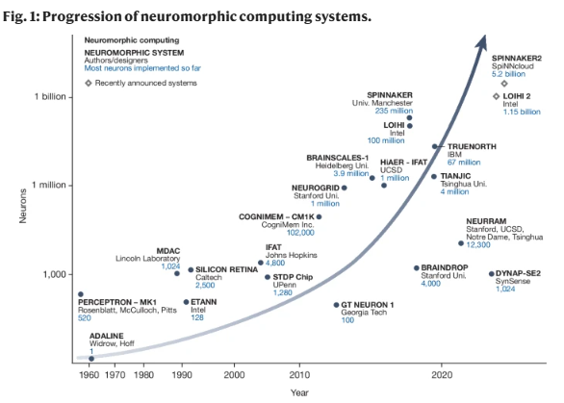
Today’s digital neuromorphic systems are approaching brain-scale
Systems like Intel’s Loihi 2 and SpiNNCloud’s SpiNNaker 2 can surpass 1 billion neurons
Individual chips are ~1 million neurons and ~1 Watt
Fully CMOS (little fabrication risk)
Digital or Digital + Analog hybrid
Future devices and novel materials can amplify potential impact
Kudithipudi et al., Nature 2025

Slide 6
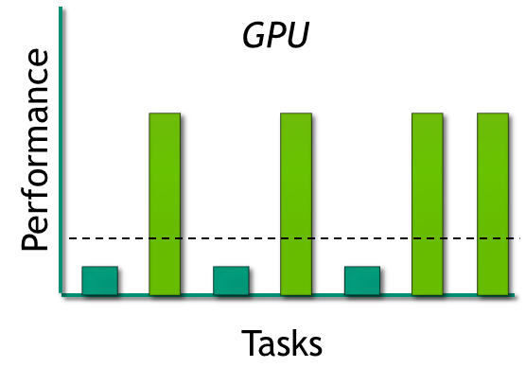
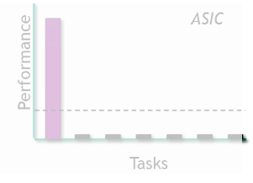
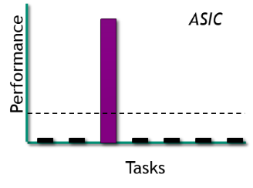
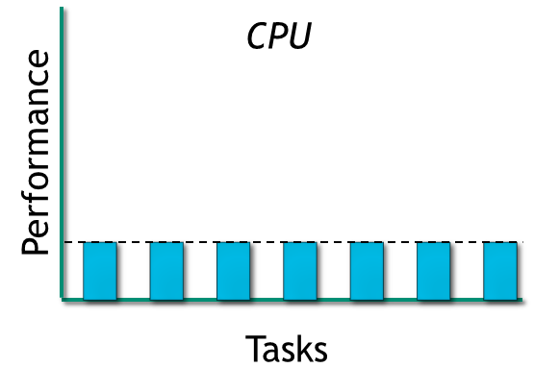
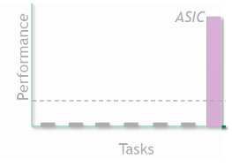
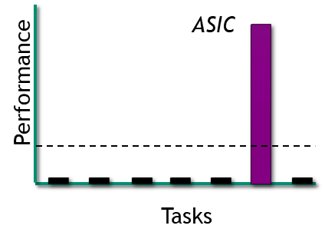
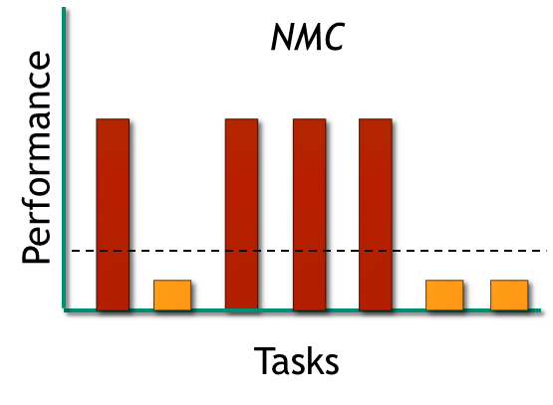
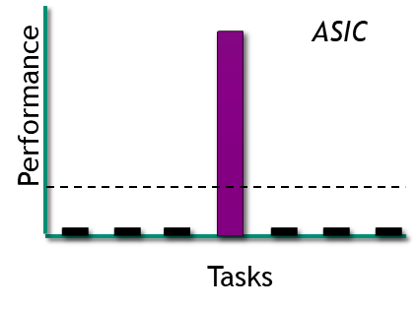
Neuromorphic is likely similar to GPUs in degree of specialization
Truly General Purpose
Specialized General Purpose
Application Specific

Slide 7
Claim: the major challenge to neuromorphic computing today is the algorithm impact
Identifying neuromorphic advantages today will
Communicate the fundamental value proposition of neuromorphic specific
Compare the scope of neuromorphic impact to alternatives (GPUs, accelerators, etc)
Clarify what aspects of today’s neuromorphic architectures need to be improved
Justify cost of moving to new non-CMOS materials

Slide 8

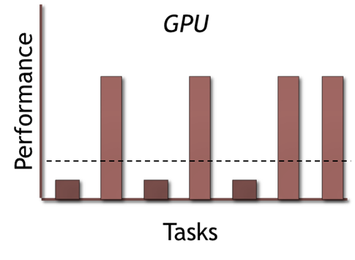
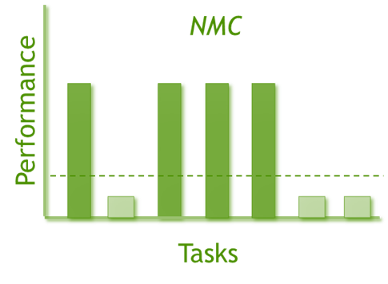
Separating the “can do” from the “should do”
Can implement on NMC, but only to avoid I/O
Arithmetic (adding, subtraction, multiplication, etc.)
Data filtering
Sorting
Data conversions
…
Possibly good on NMC, but there may be alternatives
Deep learning / conventional artificial neural networks
Parallel data processing (background and change detection, convolutions, etc)
Linear algebra (MVM, cross-correlations, L1-norm, etc)
Classic machine learning (SVMs, k-nearest neighbors, clustering)
Should implement on NMC once systems reach scale
Algorithms the brain actually uses (* we don’t have these yet…)
Random walks / Discrete Time Monte Carlo
Some Graph Algorithms (Dynamic programming, Djikstra, triangle counting, graph cut, etc)
Some neural networks

Slide 9
So is there actually a neuromorphic advantage?
Neuromorphic advantage: an algorithm that surpasses conventional architectures on one performance axis (energy, time, accuracy) while demonstrating equivalent (or better) performance on all other axes
Machine Learning
Scientific Computing
Sensing and Autonomy

Slide 10
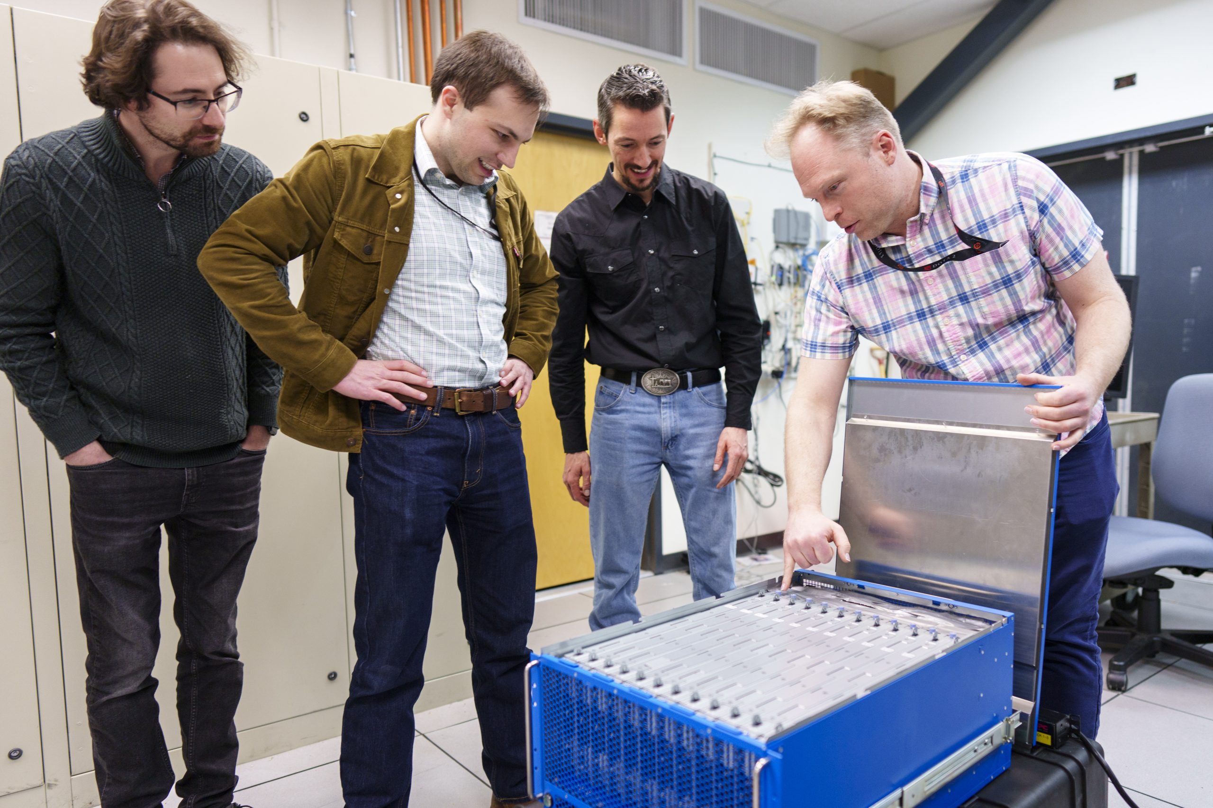
What is neuromorphic computing today?
In digital silicon (CMOS) technology
Over 1 billion neuron system at Sandia
Roughly the number in a parrot or small primate brain
Neurons are “simulated” in an efficient way
Generally a leaky integrate-and-fire model
Analog systems
Wide range of technologies, but far smaller
Emulate the brain’s biophysics in different materials
Wide range of neural dynamics emulated
Left to right: William Chapman, Brad Theilman, Craig Vineyard, Mark Plagge

Slide 11
What is neuromorphic computing today?
In digital silicon (CMOS) technology
Over 1 billion neuron system at Sandia
Roughly the number in a parrot or small primate brain
Neurons are “simulated” in an efficient way
Generally a leaky integrate-and-fire model
Analog systems
Wide range of technologies, but far smaller
Emulate the brain’s biophysics in different materials
Wide range of neural dynamics emulated
Left to right: William Chapman, Brad Theilman, Craig Vineyard, Mark Plagge

Slide 12
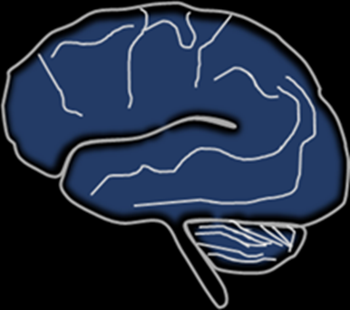
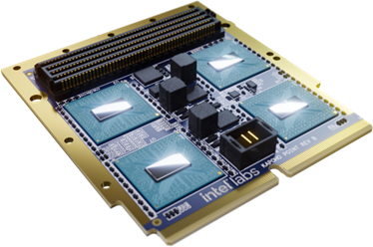
Rationale: Efficiency protects us from being trapped by two trivial conclusions
Universal Function Approximation
For any continuous f, there is a feedforward neural network Φ that approximates f
Turing Completeness of McCulloch-Pitts
Neurons with binary outputs, including spiking neurons, can implement universal logic gates, and thus can build circuits that perform any computable calculation
No guarantee of efficiency
The brain (very) likely only computes what the brain is efficient at computing
Neuromorphic should have many of the same restrictions

Slide 13
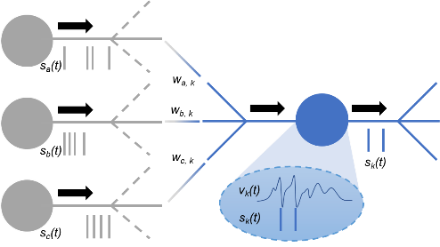
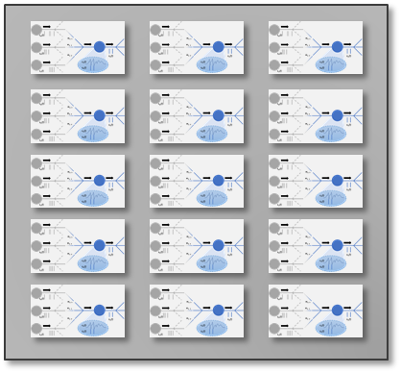
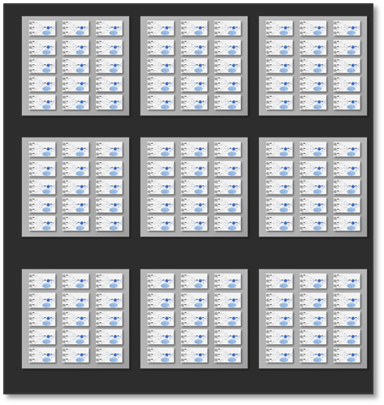
Spiking neuromorphic today: Overview
Neural Logic Core
~10³ – 10⁴ neurons
10⁵ -10⁶ edges
Neural Chip
~10¹ - 10² cores
10⁴ -10⁶ neurons
Computational Primitives:
Spiking Neurons (vertices/nodes)
Synapses (connections/edges)
Programmable as arbitrary graphs
Edges: Directed and weighted
Nodes: Threshold gate logic + time
Artificial neural networks are a special case
Programmability, theoretical, analysis, and software are open research questions
Neural System
~10² - 10⁴ chips
10⁶ -10⁹ neurons

Slide 14

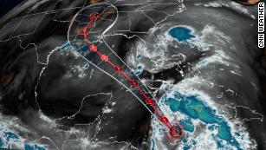
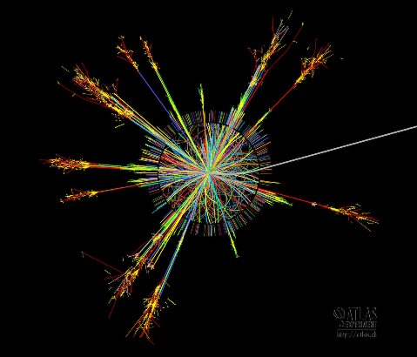
Computing applications face challenges in uncertainty
Artificial Intelligence
Bayesian neural networks are appealing yet often computationally intractable
Modeling and Simulation
Modeling uncertainties is critical in the use of even fully deterministic simulations
Many applications are inherently stochastic in their physics and are best modeled using probabilistic methods

Slide 15
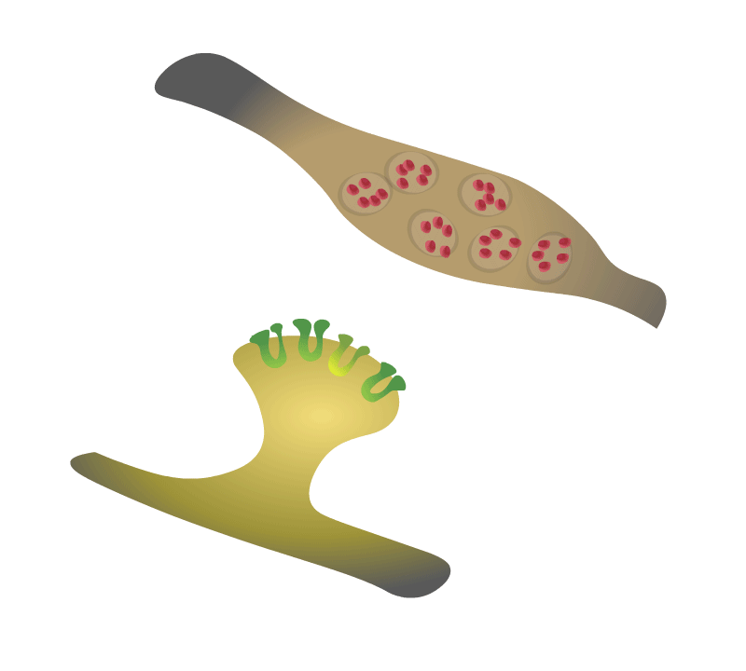
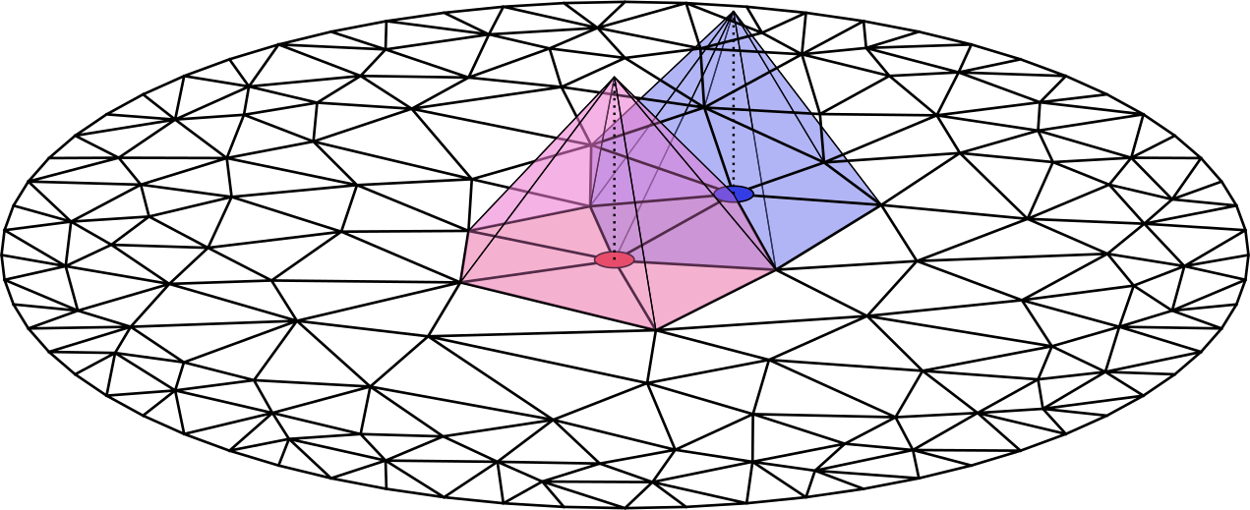
Problems that require widespread sampling
Problems that are naturally spatially distributed

Slide 16
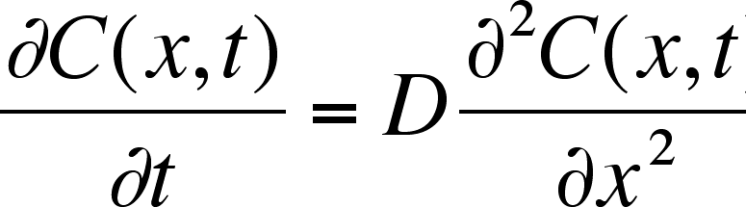
Diffusion
Diffusion can be modeled either as a deterministic PDE or a stochastic process
For an initial distribution of particles, P₀, what is distribution of particles at time t?
PDE solves the following equation
Stochastic process implements many random walkers to statistically approximate a solution
Mean position of N walkers approaches expected mean of deterministic solution at rate of 1/sqrt(N)

Slide 17
“Naïve” way to run diffusion on GPUs
For every particle “owned” by this GPU
… loop through 100,000 time steps
… draw two random numbers
50% chance to pick up or down…
50% chance to pick left or right…
… mod back to torus
Easy to do
Embarassingly parallel over particles
Mostly independent of size of state space
Particle location in computer is independent from location in model
High cost of inhomogeneity
Lots of random number draws

Slide 18
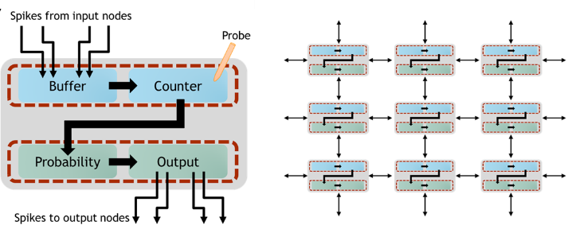
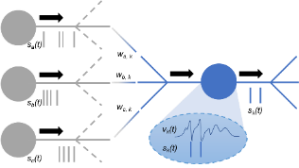
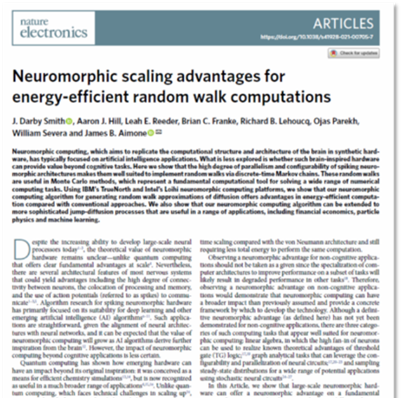
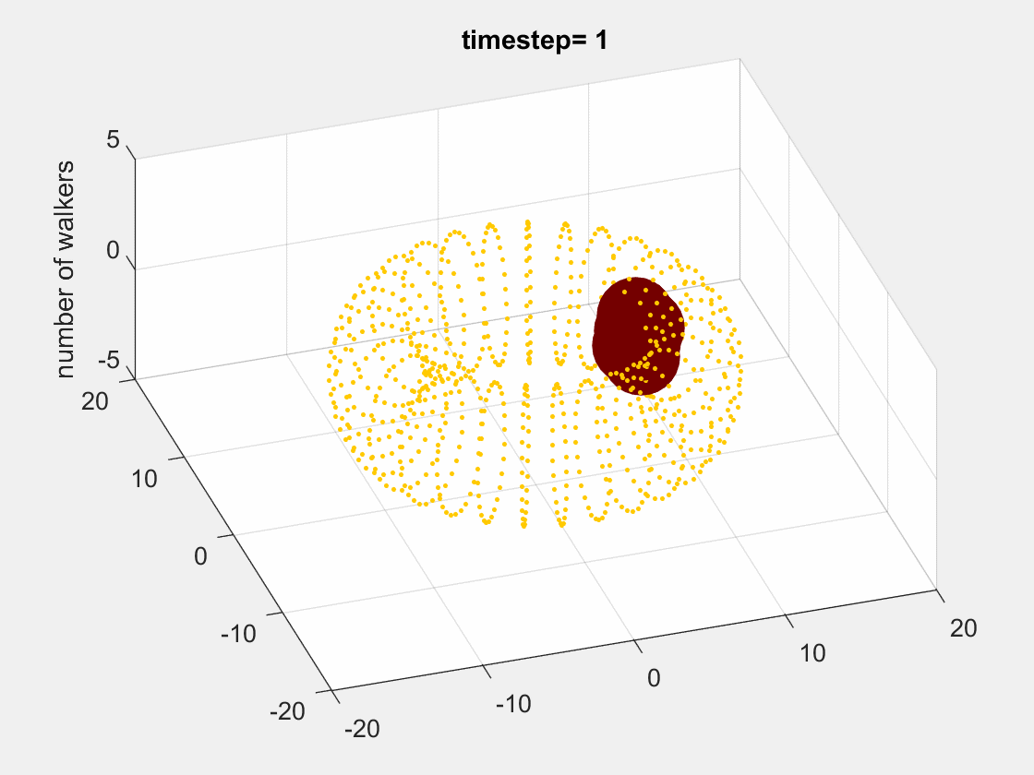
Flip the approach! Use neurons to represent state space of Monte Carlo and use spikes to represent particles
Leaky integrate-and-fire neuron
Smith et al., Nature Electronics 2022

Slide 19
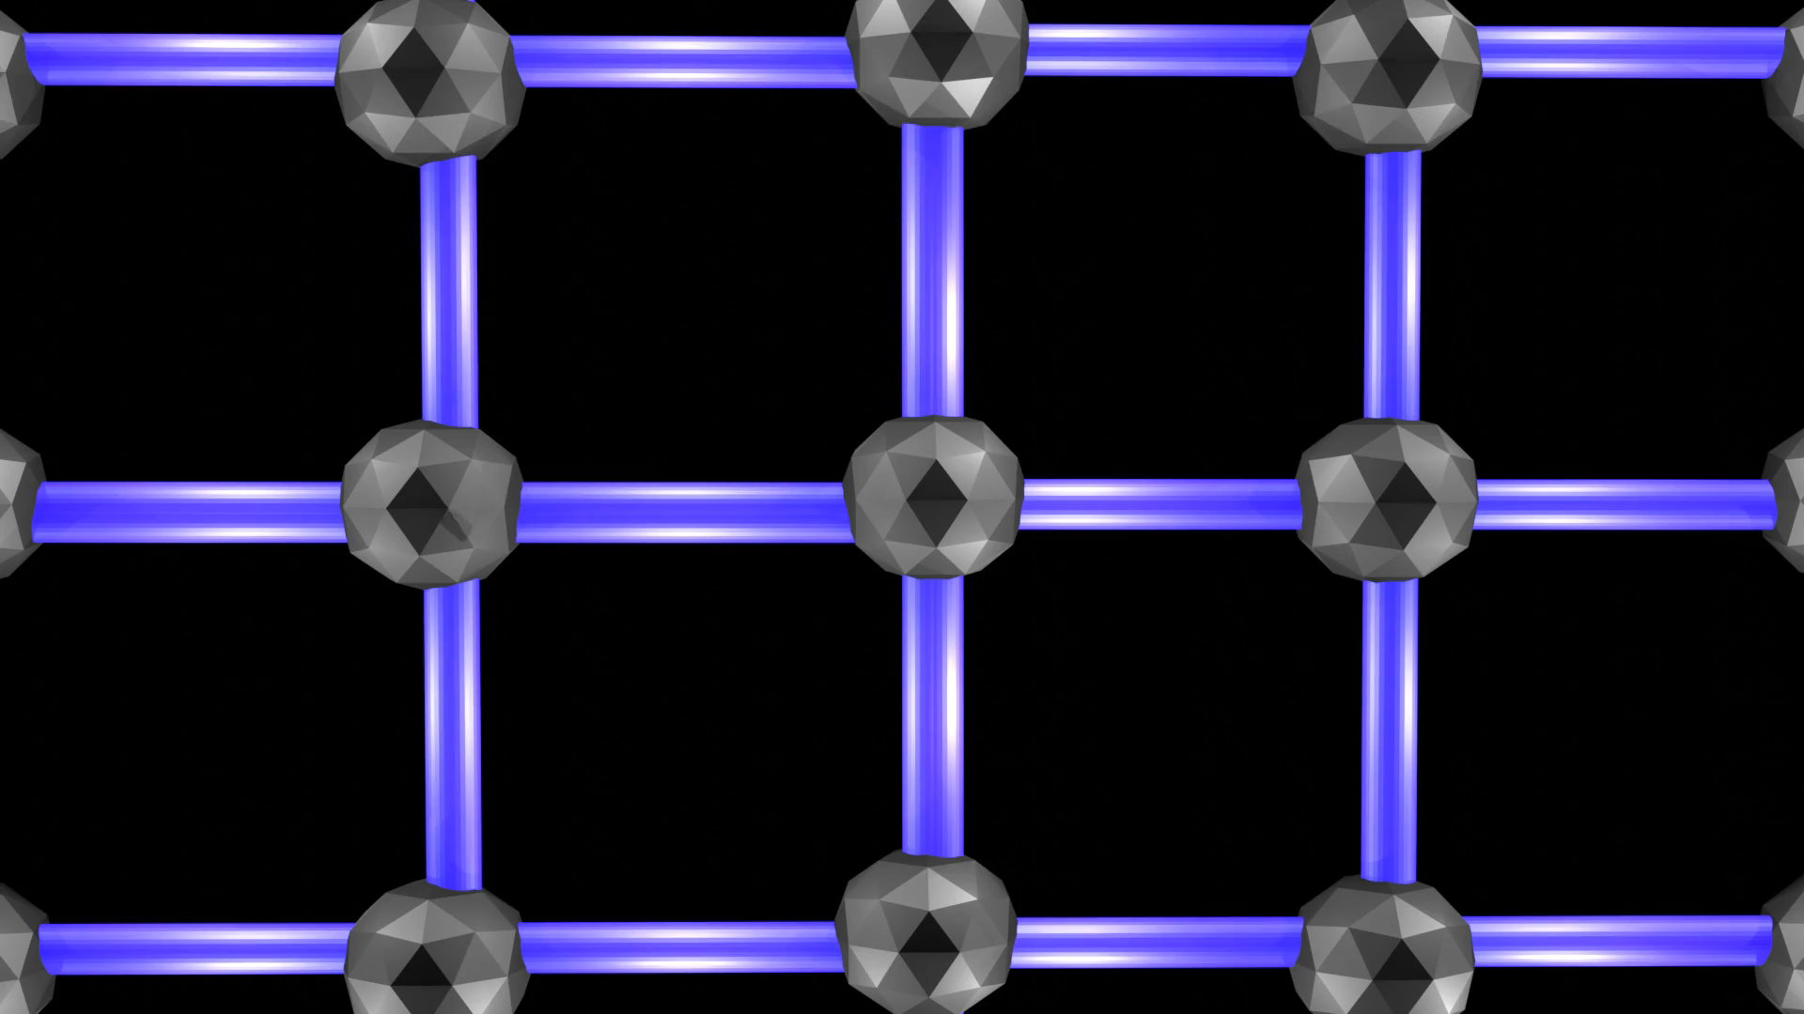
Neuromorphic computing advantage appears to be when an algorithm can split the task across computational graph with sparse communication

Slide 20
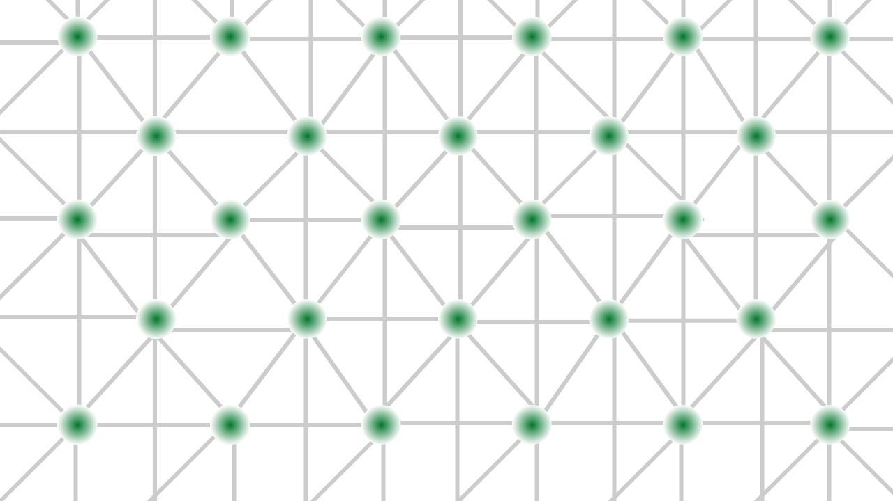
Neuromorphic computing advantage appears to be when an algorithm can split the task across computational graph with sparse communication

Slide 21
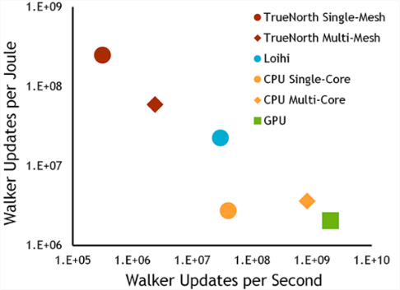
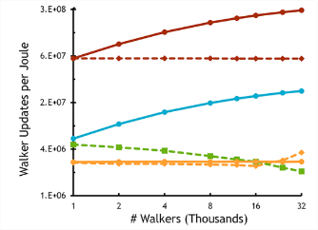
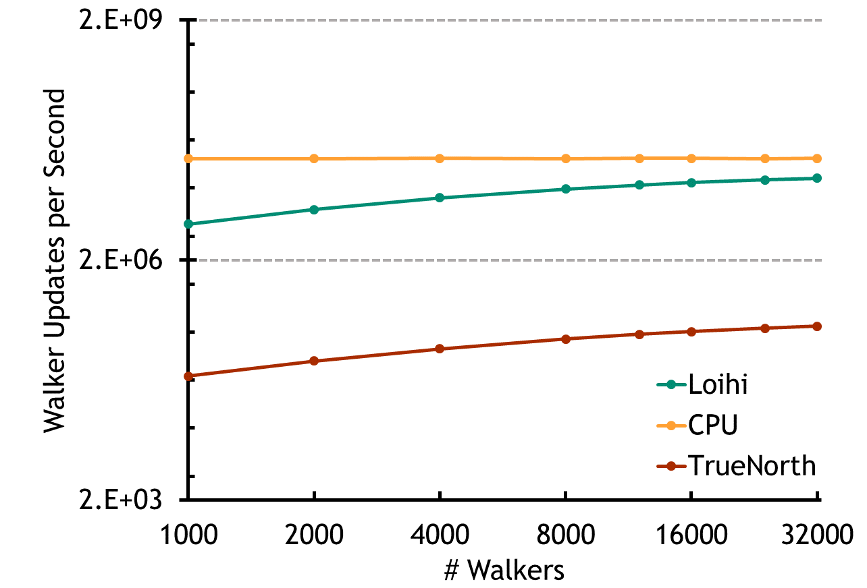
We can identify a neuromorphic advantage for simulating random walks
We define a neuromorphic advantage as an algorithm that shows a demonstrable advantage in terms of one resource (e.g., energy) while exhibiting comparable scaling in other resources (e.g., time).
Smith et al., Nature Electronics 2022

Slide 22
Math: What PDEs can these stochastic processes be useful for?
Class of Partial Integro-Differential Equations:
Stochastic Process:
NMC Hardware Simulates This Stochastic Process
Solution to initial value problem (u(0,x)=g(x)):
Monte Carlo Approximates This Expectation
Smith et al., Nature Electronics 2022

Slide 23
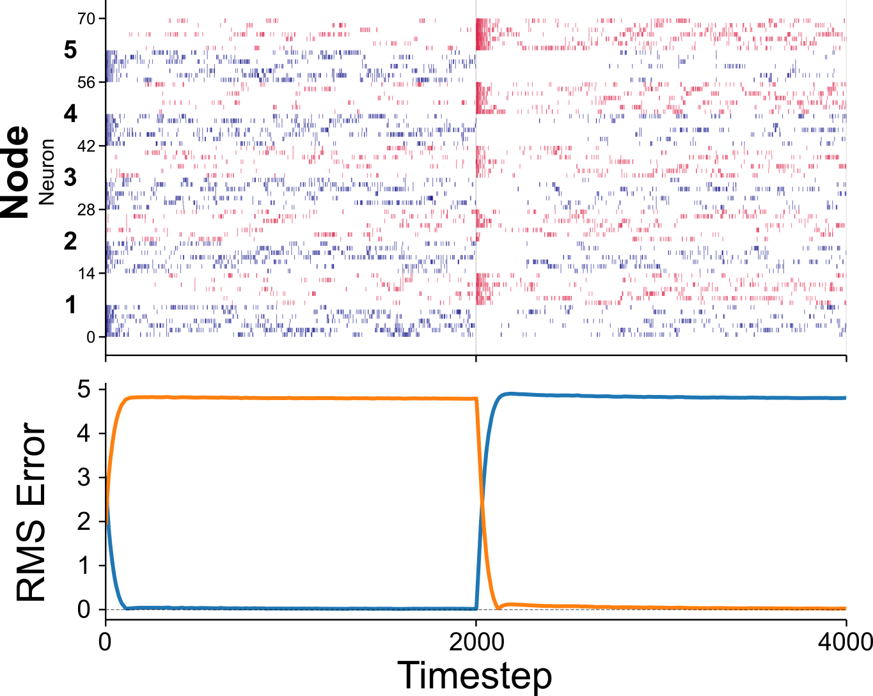
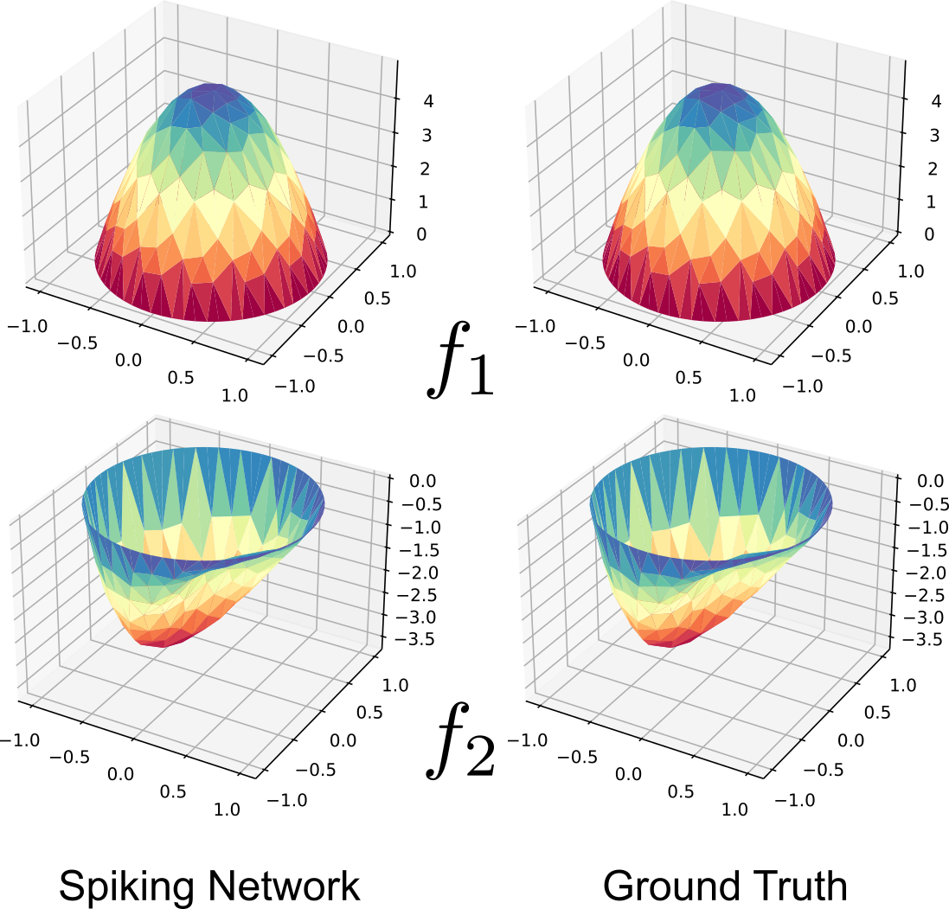
Neuromorphic hardware can efficiently solve stochastic Monte Carlo simulations
Neuromorphic hardware can efficiently solve finite element method simulations
Smith et al., Nature Electronics, 2022
Theilman et al., in review

Slide 24
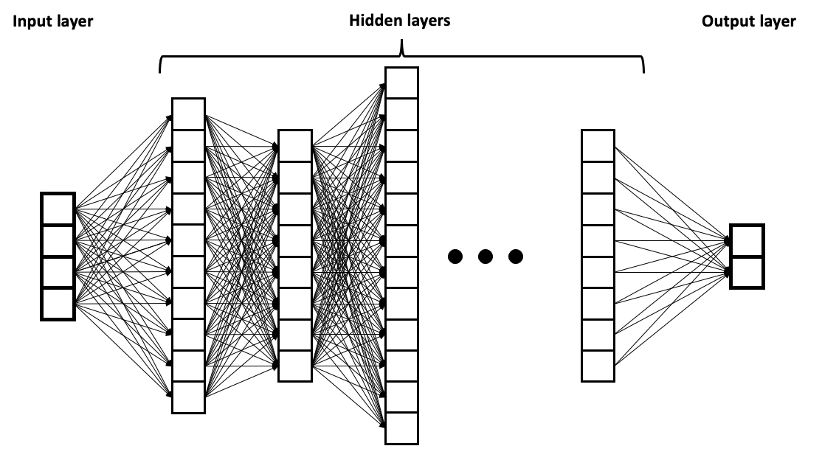
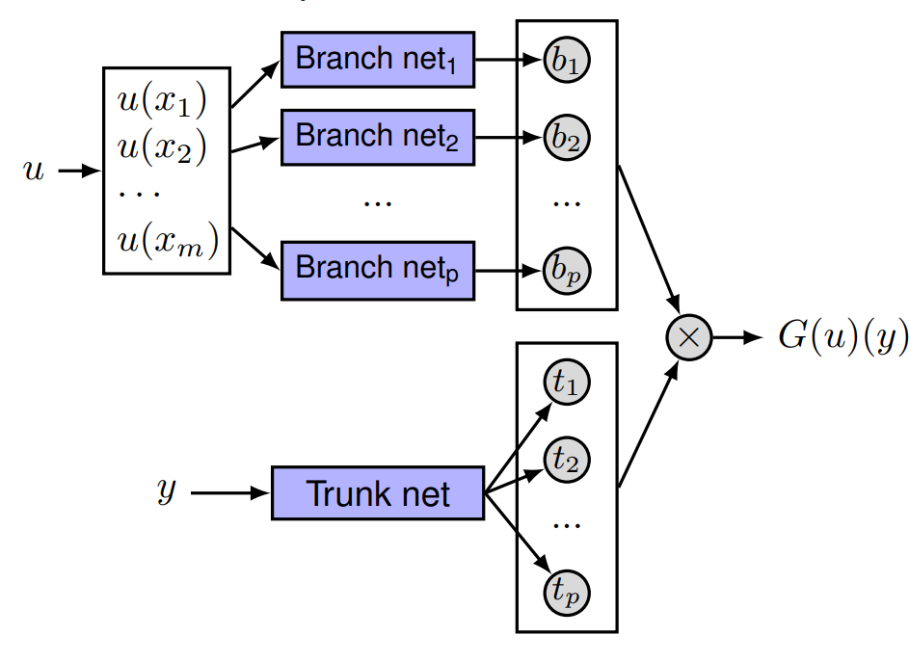
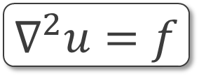
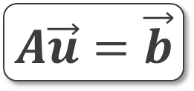
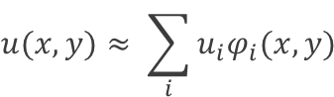
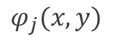

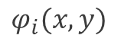
Solving partial differential equations is a major challenge to emerging computing platforms
Scientific Machine Learning
$$∇^{2}u=f$$
Finite Element Methods – Gold Standard but expensive
$$φ_{i}(x,y)$$
$$φ_{j}(x,y)$$
Physics-Informed Neural Networks
$$u_{t}+N\left[u; λ\right]=0$$
Single solution
Ω
Basis functions
Raissi, Perdikaris, Karniadakis 2019
Deep Operator Networks
$$u(x,y)≈ \sum_{i}{u_{i}φ_{i}(x,y)}$$
Coefficients
Coefficients
Basis functions
$$A\vec{u}=\vec{b}$$
Sparse, linear system
Lu, Jin, Pang, Zhang, Karniadakis 2021
NEUROMORPHIC FINITE ELEMENT METHODS?
Notes:
What are the conceptual limitations of each approach?
Last 40 years, we can predict severe weather within a short time window using finite-element style methods
Success of modsim for modern engineering is because of right (FEM) The question is, why are people chasing stuff on the left.
NNs and function approximation will reduce cost of running these models.
Not clear that left will scale precision/complexity/cost
What’s on the right allows us to do what’s on the left!
Neuromorphic question: what do you want to implement in neuromorphic? PINN (ROM)?
Doing FEM in neuromorphic
Which of these solutions does the brain do? ??

Slide 25
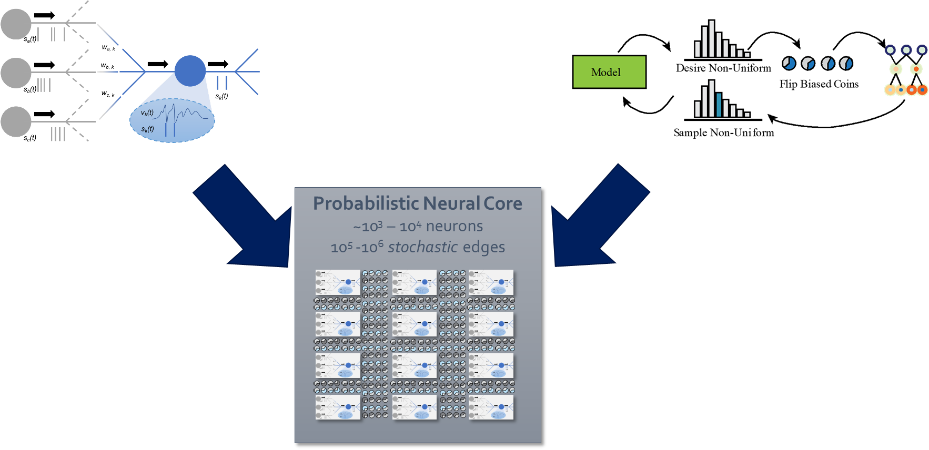
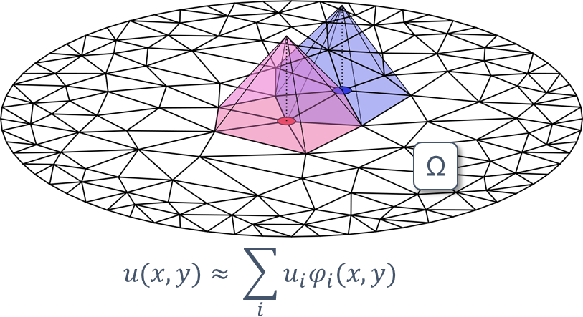
Can we tackle FEM with probabilistic neural hardware?
?????
Arxiv: 2501.10526

Slide 26
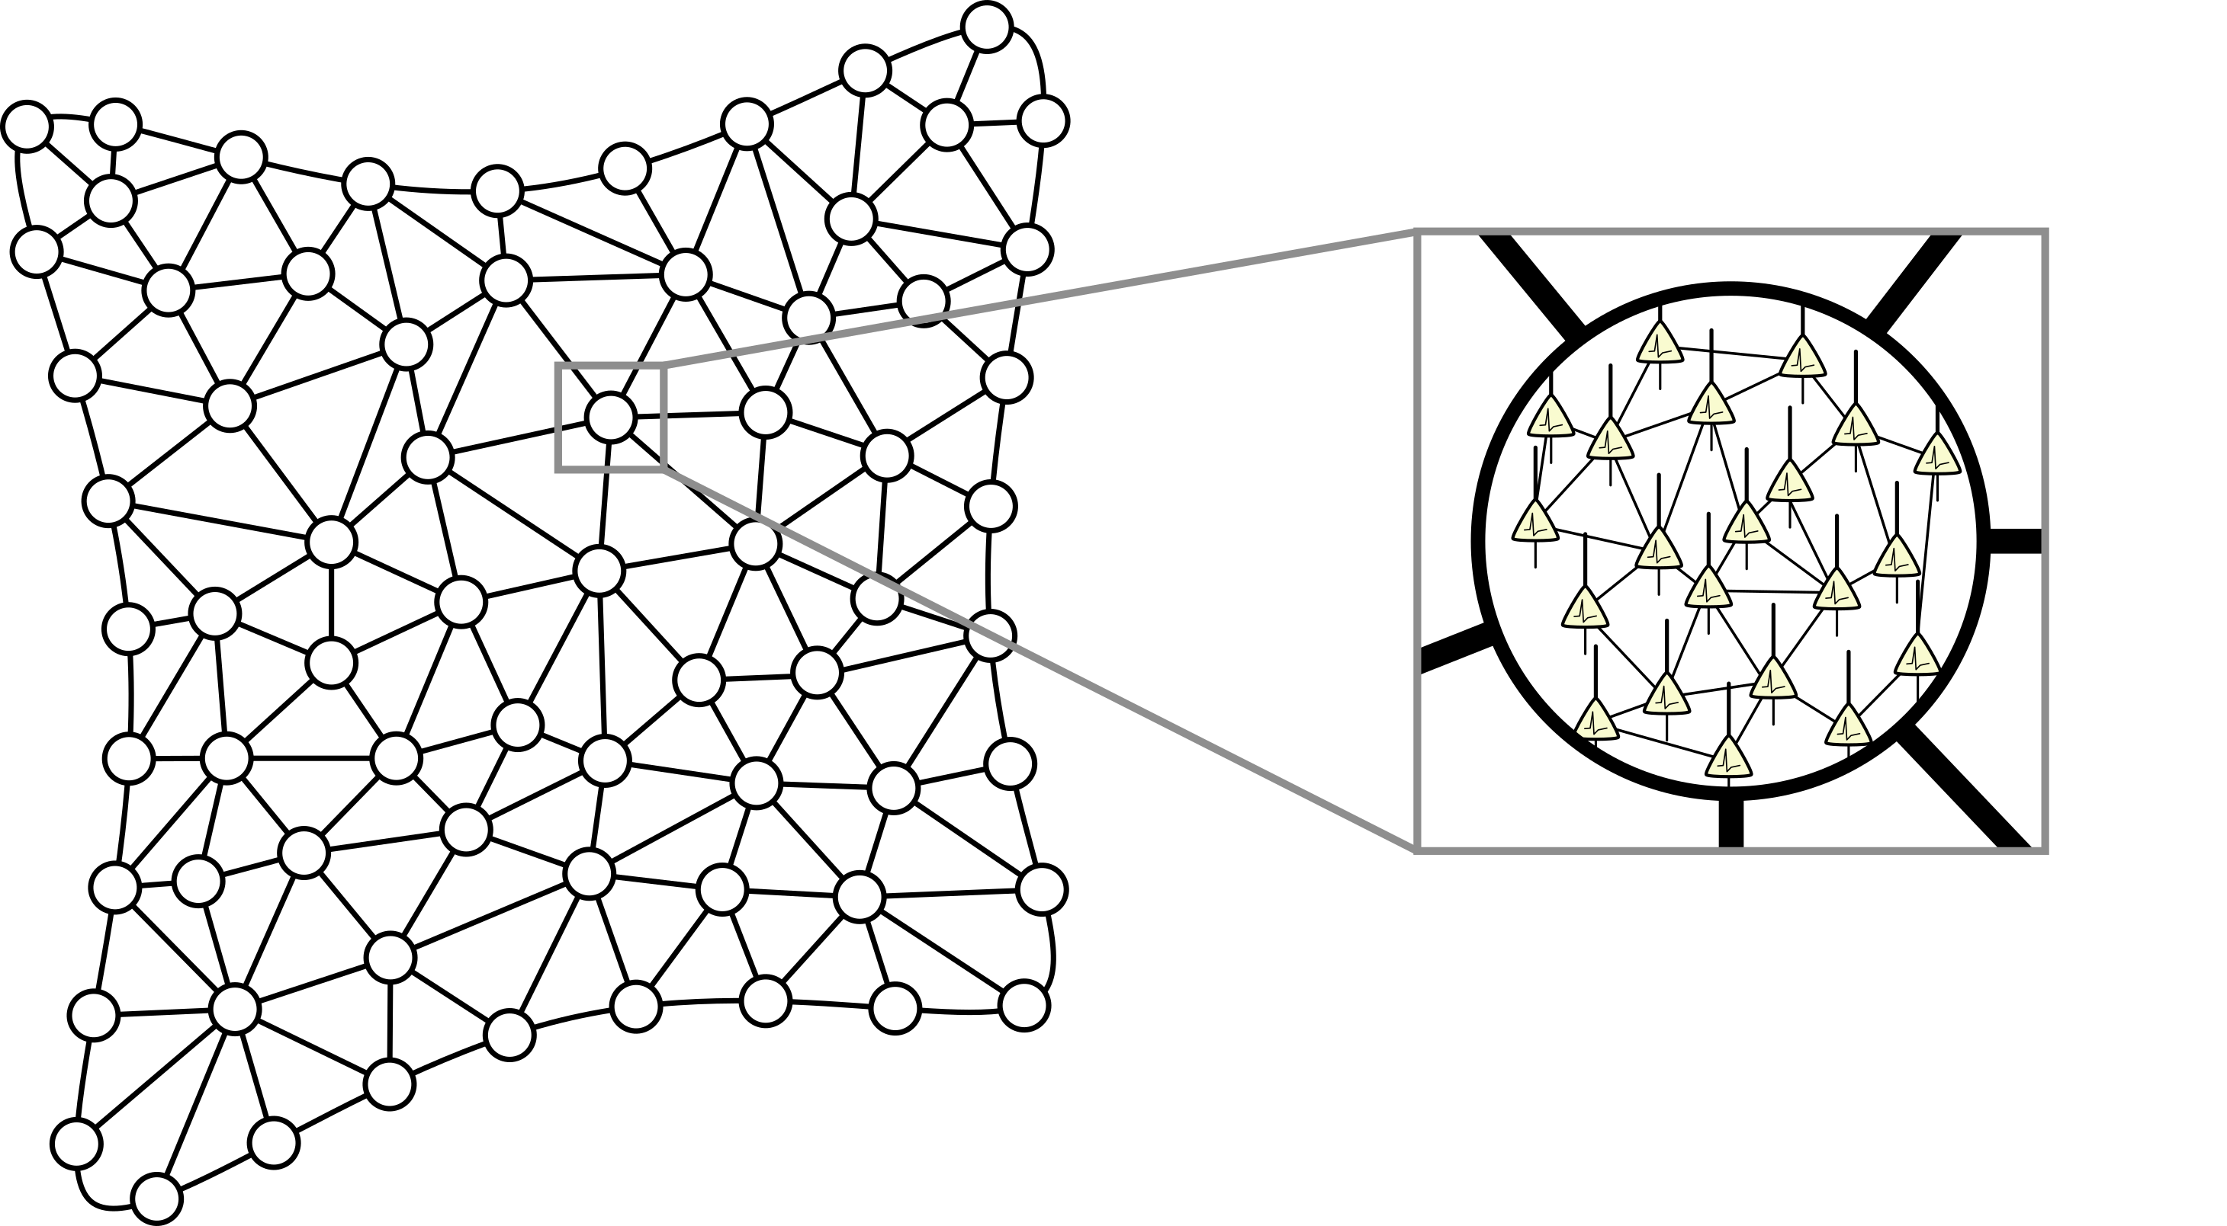
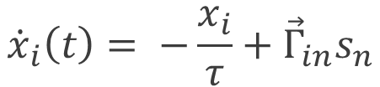
FEM – SNN MAPPING
Each node “contains” a population of neurons
Neurons within a node connect locally within the node and to neighboring nodes
$${{\dot{x}}_{i}\left(t\right)= {−\frac{x_{i}}{τ}+\vec{Γ}}_{in}s}_{n}$$
Neurons within a node project to the solution variable associated to that node
Arxiv: 2501.10526

Slide 27
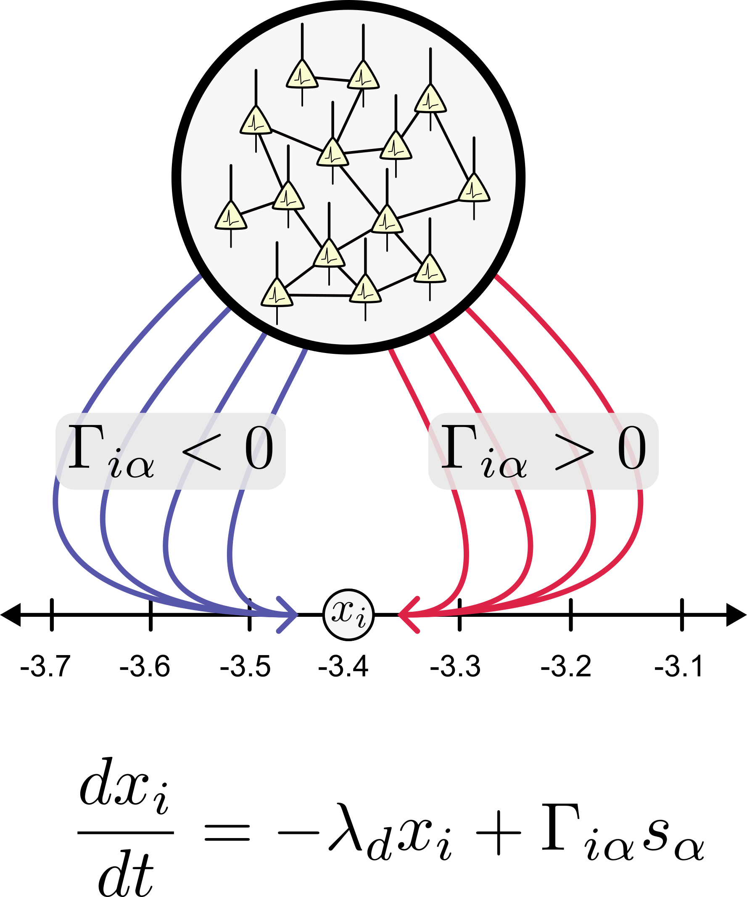
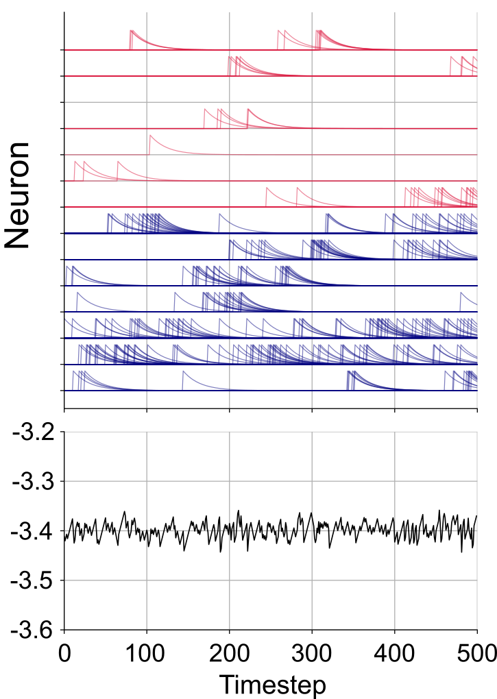
Arxiv: 2501.10526

Slide 28
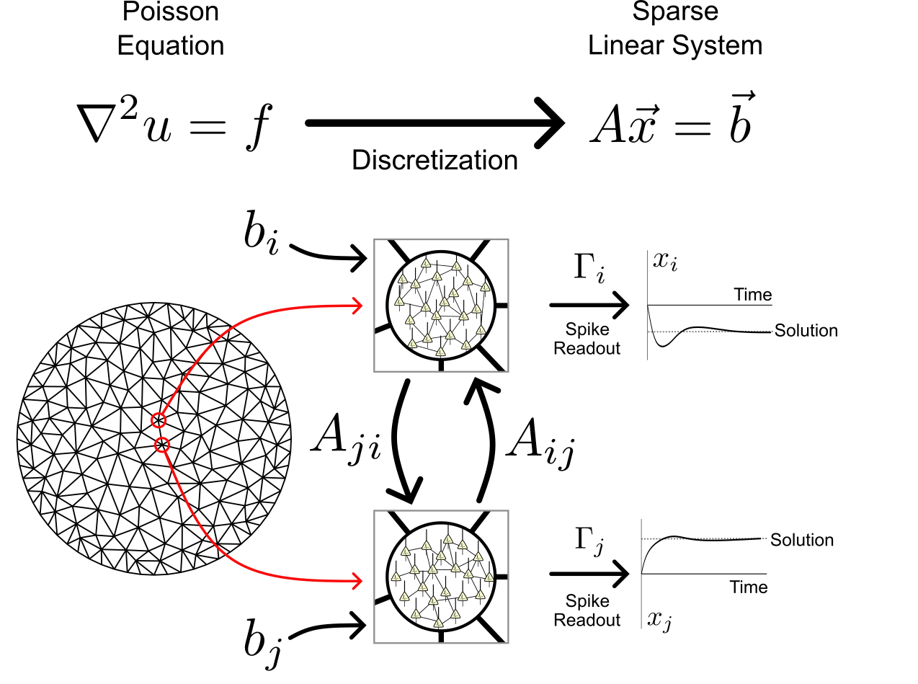
Neuromorphic virtues:
Locally dense, globally sparse connectivity
Scalable: neighbors ~ O(1)
Sparse spiking activity
Arxiv: 2501.10526

Slide 29
Arxiv: 2501.10526
Notes:
Stop and see if people want more detail

Slide 30
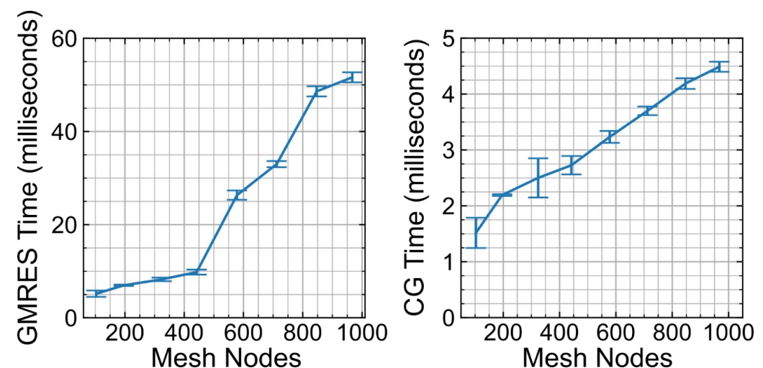
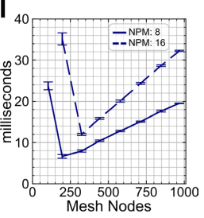

NeuroFEM is similar in speed to GMRES and Conjugate Gradient
Neuromorphic solution is general
Conjugate gradient is faster at small scales, but can only be used for symmetric matrices
Arxiv: 2501.10526

Slide 31


NeuroFEM shows compelling strong and weak scaling
Strong Scaling
Weak Scaling
Arxiv: 2501.10526

Slide 32
Conclusion: We are beginning to understand the landscape for where neuromorphic computing is effective
Known strengths and hardware opportunities
Probabilistic algorithms, particularly sampling algorithms (e.g., Monte Carlo, stochastic optimization)
Invest in stochastic devices and embedded TRNGs?
Locally dense, globally sparse iterative algorithms (e.g., sparse linear systems, control algorithms)
Hybrid digital/analog neuromorphic?
Graph algorithms, particularly with heterogeneous computations
More brain-like fan-in / fan-out?
Dynamical and continual-learning neural networks
Improved I/O

Slide 33





These neuromorphic advantages are perhaps closer to biology than people may realize
Widespread sampling by neural circuits
Distributed control dynamics to describe action space

Slide 34




Thank You!
Neuromorphic Monte Carlo Team
Darby Smith, Michael Krygier, William Severa, Ojas Parekh, Rich Lehoucq, Aaron Hill
Neuromorphic Testbed Team
Craig Vineyard, Suma Cardwell, Aaron Hill, Srideep Musuvathy, Felix Wang, Fred Rothganger, Frances Chance, Corinne Teeter, Mark Plagge, Ryan Dellana
Neuromorphic FEM
Brad Theilman
COINFLIPS team
Shashank Misra, Conrad James, Darby Smith, Suma Cardwell, Brad Theilman, Ojas Parekh, Yipu Wang, Chris Allemang, William Severa, Prasanna Date, Andy Kent, Laura Reim, Les Bland, Bernd Surrow, Jean Anne Incorvia, Jaesuk Kwon, Sam Liu, Katie Schuman, Karan Patel
jbaimon@sandia.gov

